Slide 1
Integrated Literacy Assignment
Sarah Park

Slide 2
GLCE’S
3- G5.0.1 Locate natural resources in Michigan and explain the consequences of their use.
3- E1.0.3 Analyze how Michigan’s location and natural resources influenced its economic development (e.g., how waterways and other natural resources have influenced economic activities such as mining, lumbering, automobile manufacturing, and furniture making).

Slide 3
Poetry
http://www.funny-poems-for-free.com/Michigan-Poetry-Book.html

Slide 4
Online lessons
https://www.youtube.com/watch?v=nAFpRiecpqk
http://www.soolocks.com/soo-locks-web-cam-12/

Slide 5
Textbooks
Our Michigan Adventure
Meet Michigan

Slide 6
Activity Books
Resources to Riches
Getting to Know Michigan

Slide 7
The Lorax

Slide 8
Games
Michigan Bingo
Michigan Taste Test

Slide 9
Content Magazines
Michigan History for Kids: Logs to Lumber
The Mitten: Michigan’s White Pine Era

Slide 10
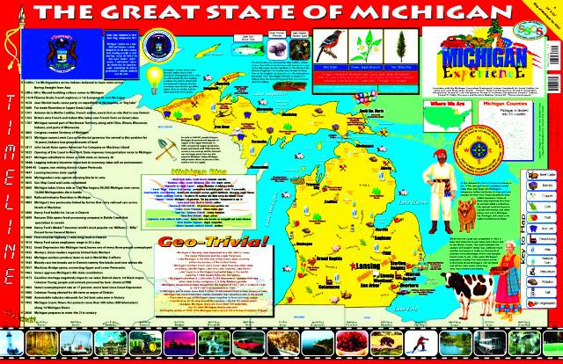
Maps

Slide 11
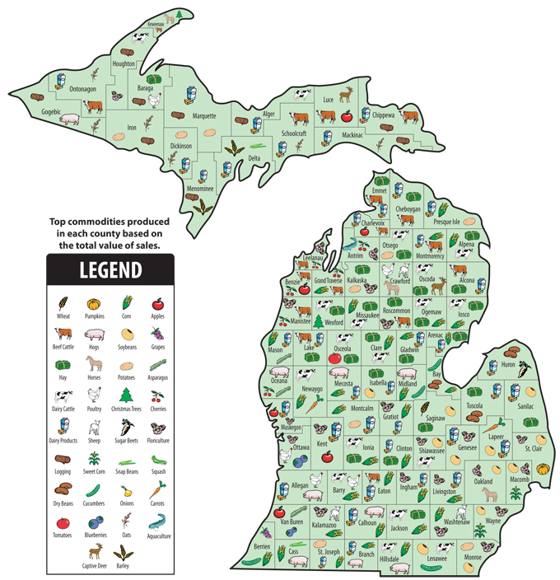
Maps

Slide 12
Timeline

Slide 13
Song
http://www.funny-poems-for-free.com/Michigan-Poetry-Book.html

Slide 14
Websites
http://scope.oakland.k12.mi.us
http://bentley.umich.edu/research/teaching/lummin.php

Slide 15
Work Cited
Fredlund. "History of Michigan." N.p., Oct. 2011. Web. Sept. 2014. <https://www.youtube.com/watch?v=nAFpRiecpqk>.
Funny Poems For Free. N.p., 2008. Web. Sept. 2014. http://www.funny-poems-for-free.com/Michigan-Poetry-Book.html.
Getting to Know Michigan 2007: . Print.
"Lumbering: the Work." Bentley Historical Library. University Of Michigan, 2013. Web. Sept. 2014.
McConnell. "Chapter 7,11." Our Michigan Adventure. Hillsdale: Hillsdale Educational, 2002. . Print.

Slide 16
Work Cited cont.
McConnell. "Chapter 5." Meet Michigan. Hillsdale: Hillsdale Educational, 2009. . Print.
"Michigan's White Pine Era.” Jan. 2003: N. pag. Print.
"Michigan History for Kids.” Fall 2004: N. pag. Print.
Oakland Schools. Oakland Schools, 2007. Web. Sept. 2014. <http://scope.oakland.k12.mi.us>.
Soo Locks Boat Tours. Gaslight Media, 2014. Web. Sept. 2014.
Suess, Dr. The Lorax. 1971. Print.

